Slide 1
Migration Discussion
IBM

Slide 2
Agenda
Why would you Migrate or Renovate Enterprise Apps?
What are the issues making Java Apps cloud-ready?
What Apps should be migrated?
What Cloud services to choose while renovating?

Slide 3
Why Renovate?

Slide 4

Why renovate or migrate?
Three reasons :
“Front-end renovation” : Building a new UI.
Lot of options in Bluemix for front-end development.
“Full renovation” : Taking advantage of Modern programming, Scaling & Services in Bluemix.
Notes:
From an enterprise perspective, there are two reasons why we see customers wanting to “renovate” their applications and make them work on Bluemix
The first is a “front-end renovation” where the customer is building a new UI (either a mobile application or a new Web UI or both) on top of existing functionality. Bluemix gives the customer a lot of options for front-end development in that case
The second is a “full renovation” where the application needs to be ported as a whole (or in large part) to Bluemix as its new platform. That’s especially true when the customer wants to take advantage of the more modern programming or scaling features of Bluemix.
Both of these have pros and cons, and there are different aspects you have to consider when doing each – but also different potential benefits to go with the challenges

Slide 5
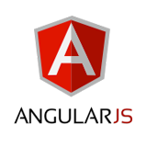


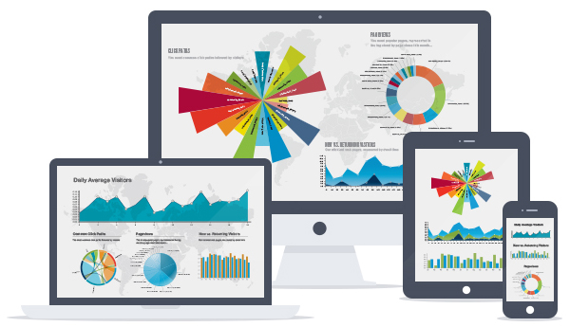
Front-End Renovation
Building a Mobile App (Hybrid or Native) using Mobile features
Building a modern Web App using Angular and Node
Exposing a public API using Bluemix for external clients
How ? Use Design Thinking : don’t take existing web page
Notes:
The big issue here is how you are doing this – you shouldn’t just take your existing web page and put it on your mobile application – this takes Design Thinking to address properly

Slide 6
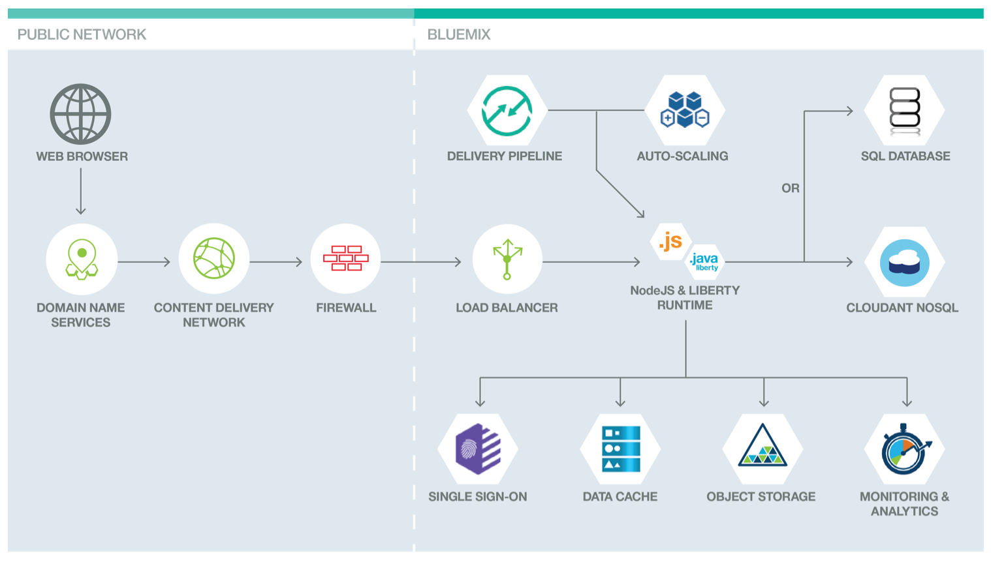
Full Renovation
Benefits:
Migrating to newer JEE features
Modernizing caching infrastructure
Modernizing database infrastructure
Modernizing monitoring infrastructure
Using APIs instead of directly connecting to back-end services
Taking advantage of a DevOps Pipeline
https://developer.ibm.com/bluemix/docs/actionable-architecture-building-web-application-hosting-cloud-foundry/
Notes:
When you’re doing a full modernization you have several new features you can take advantage of:
Migration to the newer JEE features is an obvious benefit
But you should also consider other options:
Modernizing your caching infrastructure
Modernizing your database infrastructure
Moving to APIs instead of directly connecting to back-end services
Modernizing your monitoring infrastructure
Taking advantage of a DevOps Pipeline
https://developer.ibm.com/bluemix/docs/actionable-architecture-building-web-application-hosting-cloud-foundry/

Slide 7
Considerations for Cloud Readiness

Slide 8

What does moving to Cloud mean?
Cloud-ready App can be deployed into public or private cloud
Certain architectural decisions can make Apps not cloud-ready
Cloud-centric Apps are written to run on cloud
Built using tools and runtimes different than traditional apps
For example, instead of relational database use NoSQL database
Different infrastructure dependencies
The decision on whether you
need an IaaS or PaaS is
application dependent
Notes:
Different applications may be better suited for either an IaaS or a PaaS approach. You need to approach the choice from the application’s perspective.
An existing application is Cloud-ready if it can be effectively deployed into either a public or private cloud (often but not always, an IaaS) without significant modifications.
Certain architectural decisions can make applications not cloud-ready
Cloud-centric applications are those specifically written to run on the cloud, usually within a PaaS.
These applications are built using different tools and runtimes than traditional applications.
For example, an application might not use a relational database but instead use a NoSQL database, like Cloudant or MongoDB.
A Cloud-Centric application has a different set of assumptions about what is

Slide 9

Common characteristics of Enterprise Applications
Not built with Cloud compatibility in mind
Trying to catch up to latest versions of libraries, etc.
May be built on WebSphere Stack products
Portals with WebSphere Portal Server
Departmental ESB’s built with DataPower and Integration Bus
Deep ties into internal IT
Update systems of record
Update multiple systems not specified as API’s
Deep ties into Corporate security systems (LDAP, ISAM, Siteminder) and standards
High and well-specified QoS attributes
Expectations on how often they are available and how they perform
You have to consider all of the business, architectural and design decisions of an application when moving to Cloud.
Notes:
Enterprise applications were usually not built with Cloud compatibility in mind, but may have been built with future-proofing in mind
Trying to catch up to the latest versions of libraries, etc.
May be built on WebSphere Stack products
Portals with WebSphere Portal Server
Purpose-built (Departmental) ESB’s built with DataPower and IIB
Deep ties into internal IT
Especially in cases where you not only read from, but update systems of record
May read from and update multiple systems not specified as API’s
Deep ties into Corporate security systems (LDAP, ISAM, Siteminder) and standards
Often have high, and well-specified QoS attributes
Business customers have expectations on how often they are available and how they perform

Slide 10
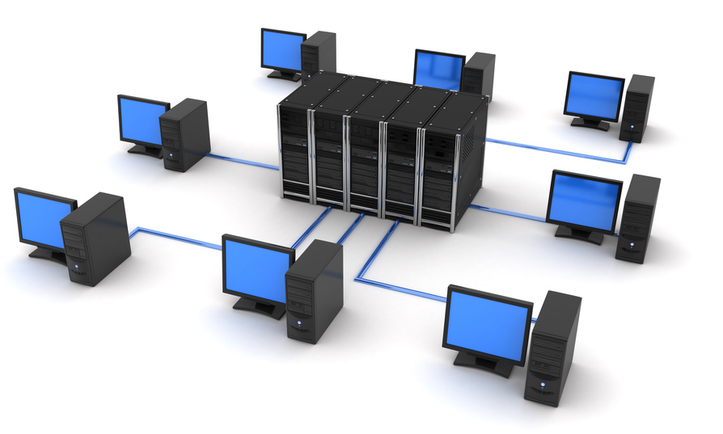
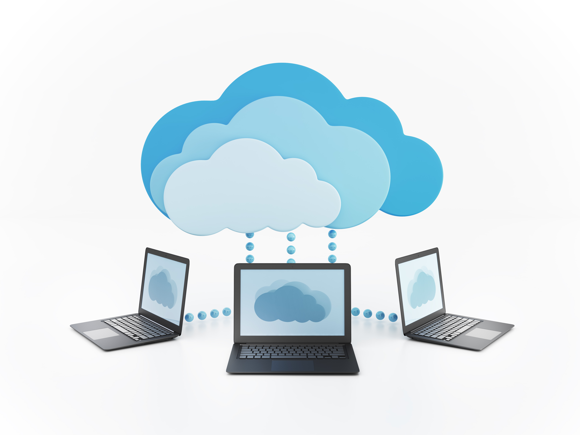
Differing Assumptions
Enterprise (Cloud Ready) Assumptions
Infrastructure is stable.
Components of my application are co-located.
Operations team controls production servers.
If a disaster happens, it’s someone’s
responsibility.
Cloud Centric Assumptions
Infrastructure is constantly changing (elastic).
Components of my application may be globally distributed.
As a Dev/Ops team member, I control production servers.
If a disaster happens, it’s my responsibility to fix it
Choosing one or the other
has an effect on your team
composition and roles

Slide 11
Making Applications Cloud Ready

Slide 12

Criteria for cloud-ready applications
Application’s design is topology-agnostic
Ex: Clustering is supported, no specific cluster size needed
Application’s management is infrastructure-agnostic
Ex: Doesn’t depend on IP addresses, hostnames, or VLANs
Application doesn't use infrastructure-specific APIs
Application doesn't use OS-specific features
Application doesn't use local file system
Application logs to persistent storage, not the file system
Application keeps session state only in the interaction layer
Application components connect via standard protocols
Application’s installation and configuration is scripted
Ex: Deployment is easily repeatable

Slide 13

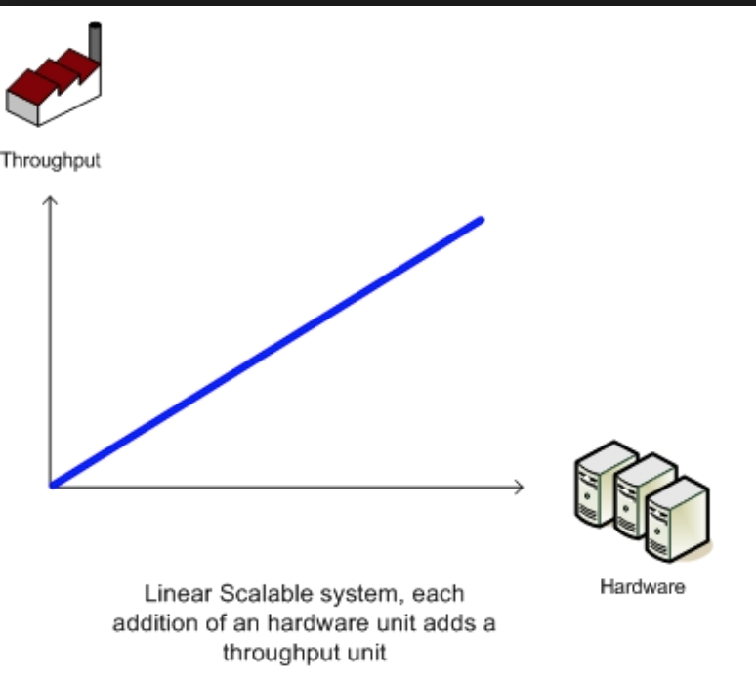


Additional considerations to port apps to Bluemix
Application Considerations:
On a recent, supported level of the runtime
Have linear, horizontal scaling
Shouldn’t hog bandwidth
Not need data at rest to be encrypted
Limits options for data sources
Notes:
Application Considerations:
On a recent, supported level of the runtime
Otherwise you’ll find your time gobbled up by porting to the newest level
have linear, horizontal scaling
Vertical scaling is just not feasible for cloud
The application shouldn’t be a bandwidth hog
This is a shared environment, after all
The application should not need data at rest to be encrypted
Seriously limits your options for data sources

Slide 14

Infrastructure Modernization for Java applications
Plan on moving to WAS Liberty
Code refactoring
Moving to EJB 3.0 or JEE Web Service Profile
Understanding dependencies on scripts, internal messaging, telecom classes etc.
Formulate Liberty migration strategy
Use Migration toolkit
Classify and evaluate applications for migration
Classification criteria (# users, uptime, #data sources, Tech stack)
Notes:
Plan on moving to WAS Liberty
Goes hand in hand with a code refactoring
Moving to EJB 3.0 (local) or JEE Web Service Profile
Understanding dependencies on “bonus” or external parts of WAS ND (scripts, internal messaging, telecom classes)
Requires formulating a Liberty migration strategy
Use the Liberty migration tool
Classifying and evaluating applications for the migration
Classification criteria (# users, uptime, #data sources, tech stack)

Slide 15
Changing your applications
App has to change in cloud migration
Need a good set of
Application tests (preferably automated)
Application performance baselines
Process to access test data
Application Refactoring
Breaking down applications by layer
Breaking down applications along functional boundaries
Breaking larger apps into smaller ones
Breaking out services
Developing shared services architecture
2
UI Layer
1
Service Boundary
Business Logic Layer
Data Services Layer
Data Sources
3
Notes:
In cloud migrations, application has to change at some level
The only way this works is if the customer has a good set of
Application tests (preferably automated)
Application performance baselines
Good processes for gaining access to test data
Application Refactoring Types – Behavior preserving Transformations
1. Breaking down applications by layer
Substituting layers with 9-rules compliant replacements
2. Breaking down applications along functional boundaries
Breaking larger applications into smaller ones
3. Breaking out services
Developing a shared services architecture

Slide 16

Paying Technical Debt
Fully automated functional and performance test suite
Fully automated code and configuration deployment scheme
Clean up unneeded internal dependencies
Refactor to classical SOA or Microservices
Modernize your services infrastructure
Add caching, monitoring, etc…
Modernize your user interface
Come up to date on framework versions
Move to Web 2.0/3.0 Hybrid model or Native mobile apps
Notes:
Fully automated functional and performance test suite
Fully automated code and configuration deployment scheme
Rationalizes your SDLC environment
Clean up unneeded internal dependencies
Rationalize/standardize on a common packaging approach and common set of 3rd party packages and jar files
Take the opportunity to refactor to either classical SOA or Microservices
Modernize your services infrastructure
Add caching, monitoring, etc…
Modernize your user interface
At least come up to date on framework versions
May want to move to Web 2.0/3.0 Hybrid model or consider Native mobile apps

Slide 17
Rebuilding Apps for Cloud Centricity

Slide 18
Design Principles for Bluemix Applications
Bluemix applications are “Born on the Cloud” :
Built using Microservices architectures
Follow DevOps principles
Built in accordance with the 12-factor.net rules
Born on the Cloud applications
Have shorter lifetime– new versions rolled out very quickly
Built using principles of polyglot programming and polyglot persistence

Slide 19
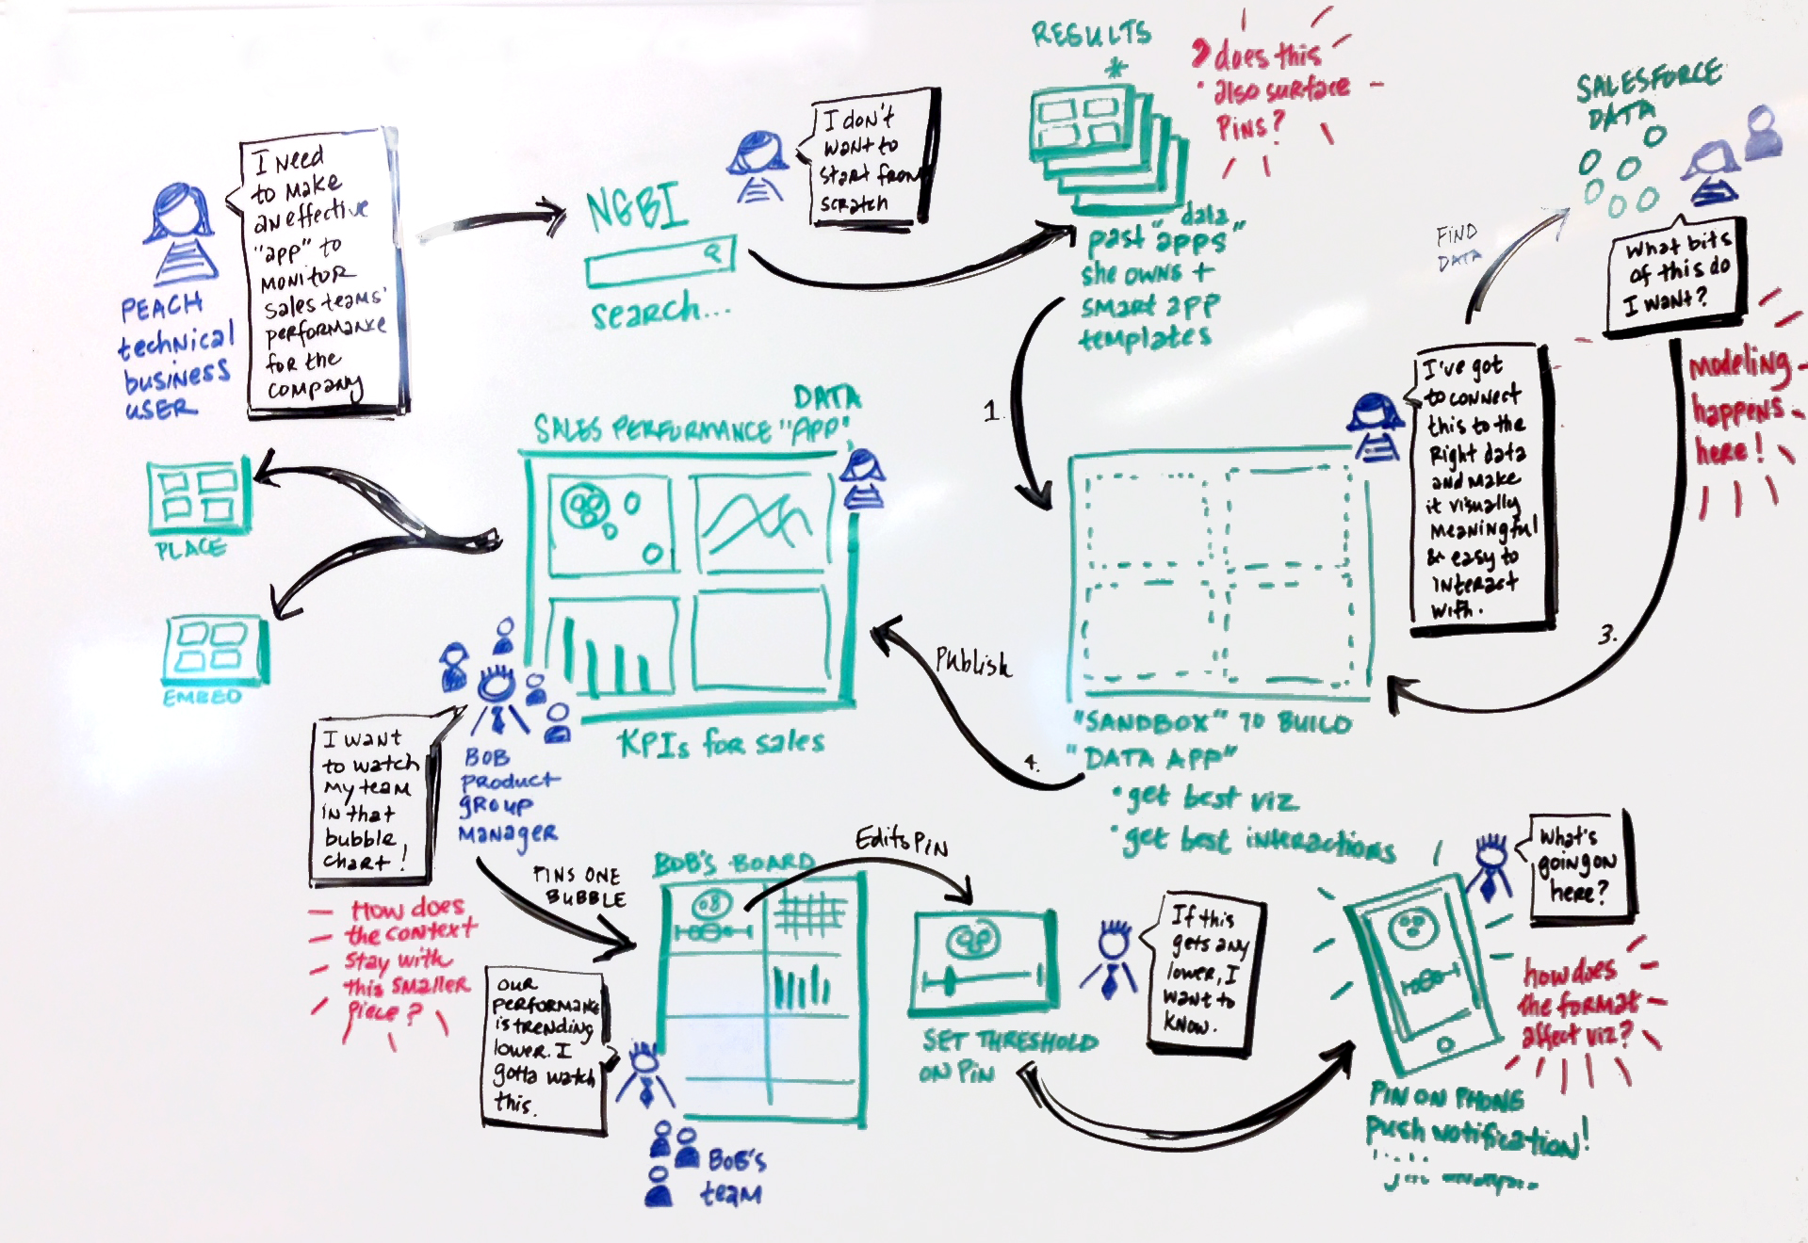
Cloud Centric Design Approach
Understand your Business Goals
Understand the target user experience
Pick your services/data sources
Determine your archetype
Pick your runtimes and libraries

Slide 20
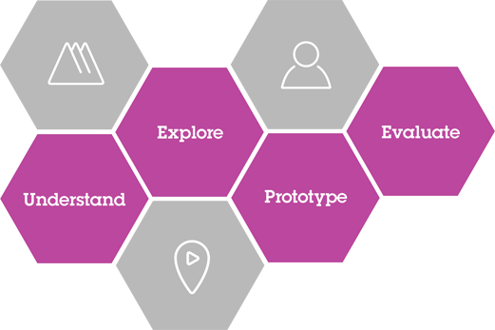
Understand the target user experience
Use IBM Design Thinking
Use IBM Design team to conduct Design Thinking Workshops
Core concepts (Hills, Sponsor Users, Playbacks) provides overall approach
Artifacts like Empathy Maps, Scenario Maps and Wireframes provide important information
Leads to implementation in Cloud environment

Slide 21
How do you get started?
Three different archetypes :
Systems of Record
Systems of Interaction
Systems of Insight
[brackets] indicates 0-N of these may be needed
System of Interaction Archetype
[Gateway] + Runtime + Data Store + [Data Movement]
System of Insight Archetype
[Visualization] + Runtime + Data Store + [Analysis Tool]
System of Record Archetype
[Gateway] + Runtime + Data Store
Two different layers of “Ecosystem Services” ca be added for functional and non-functional requirements

Slide 22
Core Services Categorization
Data Storage | Gateway | Visualization | Analysis | Data Movement, Augmentation and Validation
SQL Options | IOT | Embeddable Reporting | Analytics for Hadoop | Dataworks
NoSQL Options | Twilio | Cognitive Graph | Apache Spark | Pitney Bowes Geocoding
 | Secure Gateway | IOT Realtime Insights | BigInsights for Hadoop | Watson Natural Language Translation
 | API Management | Document Generation | DashDB
 | SendGrid |  | Geospacial Analytics
 |  |  | Streaming Analytics
 |  |  | Predictive Modeling

Slide 23








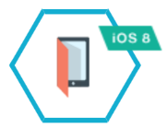





Layers of a Bluemix Application
Ecosystem
Services
Development
Archetype
Ecosystem Services
Security
Archetype
Performance Testing and Monitoring

Slide 24
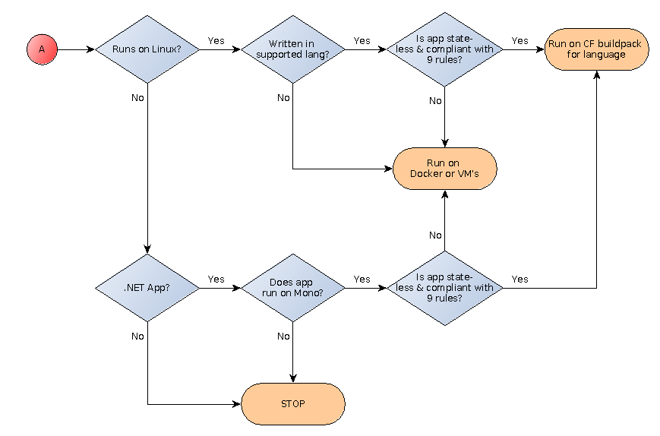
Simplified Migration Flowchart

Slide 25
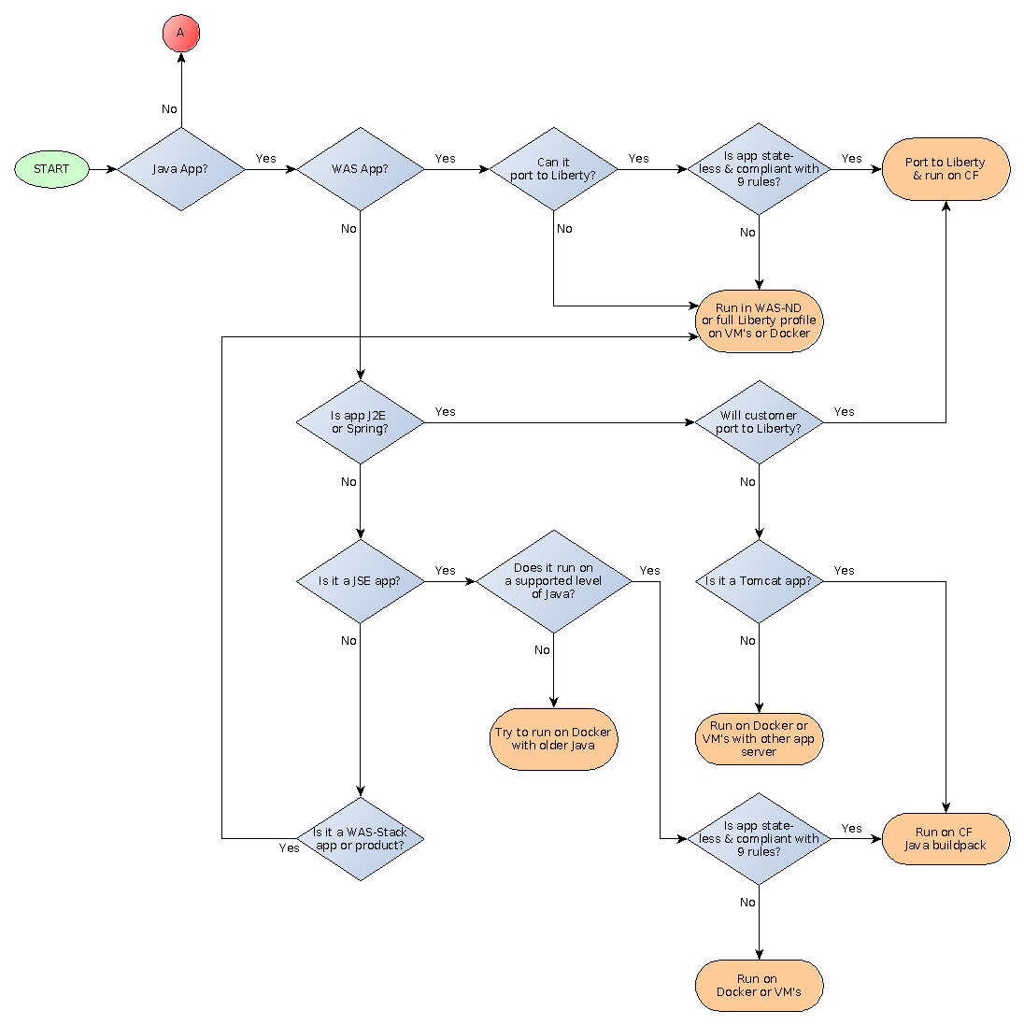
More complete Migration Options

Slide 26
 | Bluemix Cloud Foundry Runtimes | IBM Container Service | HEAT Patterns or PureApp Services Patterns
Optimal System Type | Systems of Engagement | Either | Systems of Record
Optimal Application Type | Cloud Centric | Either, but most commonly Cloud Centric | Cloud Ready
Scaling | Horizontally scaled single-process solutions (Vertical scaling limited by 4GB limit on DEAs) | High density vertically scaled single-process solutions | Horizontally scaled complex multi-process assemblies,
Composition Model | Service Composition model | Runtime assembly model compatible with Service composition | Runtime assembly model for complex multi-runtime systems
Cloud solution type | Public or managed private cloud solution | Public, Private or managed cloud solutions and local development | Private cloud solutions
DevOps Integration | Integrated with DevOps Pipeline | Integrated with DevOps Pipeline (Bluemix public) and Integrated with UCD | Integrated with UCD
Security | Limited security options | Not yet explored | Corporate Grade security options
Middleware coverage | Limited traditional middleware functionality | Limited but growing WAS and stack options | Full set of WAS stack products and partner products available

Slide 27
Choosing Core Services

Slide 28
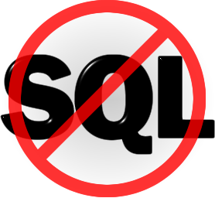
Polyglot Persistence
A basic assumption is that your application will probably have to store some data persistently (e.g. for longer than the length of a single user session)
At one time, it was a simple assumption that Web programs would run on a relational database
Multiple relational database options exist for Bluemix
However the assumption of using a SQL database (DB2, MySQL, etc.) should be challenged by the set of open-source data options collectively called “NoSQL”
These data stores are characterized into four different basic types that are each specifically qualified for different purposes

Slide 29

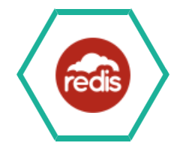




NoSQL Options
Cloudant – High Performance JSON document Database built on Apache CouchDB. Built in support for map/reduce. Useful in nearly any NoSQL situation.
Redis by Compose – BSD-licensed Key-value store. Especially useful for leaderboards and document ranking.
Mongodb by Compose – open-source document DB (documents similar to JSON objects). Often used for log data, product data management and content management.
RedisCloud and MongoLab also provide third-party Redis and Mongo hosting services.
Graph Data Store - built on Apache Tinkerpop and is especially useful for modeling social networks.

Slide 30




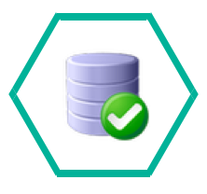

SQL Database Options
The SQL options for storing data vary by functionality and the amount of scaling and multi-tenancy that they support
The SQL Database service provides a DB2 Database (not a DB2 Instance) that is unique to a space and suitable for low-volume applications
The DB2 on Cloud Service provides a DB2 Instance that is unique to a space and can scale up to Enterprise sizes
Both DB2 options are fully compatible with existing DB2 drivers and SQL syntax
PostgreSQL on Compose and Elephant SQL (third party) provide implementations of Postgres.
ClearDB and the (experimental) MySQL Service both provide implementations of MySQL
In the end, the decision is usually based on what database the team (and their DBA’s) are most comfortable with.

Slide 31
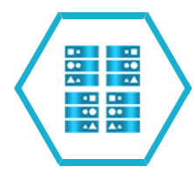


Storing Data Temporarily
For performance reasons (or for scalability of session-type data) you may find the need to store data for the duration of a user session
There’s also the need to cache commonly accessed data rather than pull it from a database, especially a relational database.
The Session Cache service is specific to the Liberty buildpack and implements the JEE Session API.
The Data Cache service implements a highly available key-value cache with API’s for Java, Node and REST
The Memcached service hosts a distributed key-value cache using the widely available Memcached API’s
These should not be used as systems of record – they are explicitly unreliable and may suffer from any of the standard problems (staleness, etc) that distributed caches suffer from. A Cache is not a database!

Slide 32



Communicating between services asynchronously
Sometimes there is the need to add asynchronicity between stages of a business application. For instance, commonly a web site will need immediate response, while processing an order could be an operation that takes hours or days.
Asynchronous messaging systems allow different services to run at different speeds
MQLight is a fully-featured AMQP-based messaging engine with clients for Java, Node, Ruby and Python
CloudAMQP hosts the open-source RabbitMQ AMQP-based messaging engine
There is also an experimental RabbitMQ Service available from Bluemix Labs.
None of these solutions is capable of being an Enterprise messaging solution or tying to those – you still need to use MQ Series and the Secure Gateway for that.

Slide 33




Communicate with the world outside Bluemix (Gateways)
A Gateway allows you to bridge between code running inside a Bluemix runtime and people and services that exist outside the Bluemix environment.
Twilio allows you to communicate via Voice and SMS
SendGrid allows you to communicate via Email
IOT allows you to send and receive MQTT messages through the Internet Of Things Foundation
API Management allows you to create Bluemix services from existing API’s in your enterprise and to manage those API’s
Secure Gateway allows you to connect to resources behind your corporate firewall
While Twilio and SendGrid normally act as Data Sinks the Secure Gateway may support limited cases of bidirectional communication

Slide 34
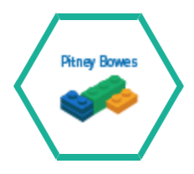




Validating, Cleansing and Converting Data
The Pitney-Bowes Geocoding and Reverse Geocoding services map GPS coordinates to postal addresses, and vice versa
DataWorks allows you to move data from one database to another and also validates postal addresses
Watson Language Translation converts text between several natural languages
Presence Insights helps you Geolocate a user’s device within a venue to provide them with location-specific information
Geospacial analytics gives you MQTT notification when a device moves within a bounded area
Think of these as pipes or filters in a data pathway. Either you’re moving data from
one place to another, or changing, converting or augmenting that data

